Slide 1
GROVES FIRE DEPARTMENT
New station presentation

Slide 2
CURRENT STATION
Built in 1956
Built for volunteer fire department
Was not manned 24/7
6,868 sq. ft.
Roof leak in SCBA room, storage closet, and mechanical room
Even after several repairs

Slide 3
CURRENT STATION
Women’s bathroom has ceiling issues.

Slide 4
CURRENT STATION
Remodeled multiple times
12 Firefighters - 3, 4 man shifts
Cramped quarters
Air condition does not keep up in summer
Plumbing issues under station that cannot be fixed
No security of station

Slide 5
CURRENT STATION
Apparatus bay is narrow
Safety hazard for firefighters
Narrow bays for apparatus when backing in and leaving
Apparatus bay floor extremely slippery on humid days

Slide 6
CURRENT STATION

Slide 7
NEW FIRE STATION
Corner of Washington and Gulf, next to Police Station
Will face Washington
14,565 sq. ft. (Building to meet current and future needs)
NFPA 1500 requires airlocks and ventilation for bay to keep out contaminants
None at current station
NFPA 1500 also requires bunker gear to be stored away from sunlight and little exposure to fluorescent lighting (UV light degrades bunker gear). This storage should also be away from living area and ventilated to exterior.
Currently stored in bay on racks close to living area

Slide 8
BUNKER GEAR RACKS

Slide 9
NEW FIRE STATION
Larger training room
Increasing outside training to public (CPR and fire safety training)
Office for Investigators and Training personnel
Fitness room (suggested by NFPA 1500)
Increased needed storage areas
Better accommodations for firefighters
Fire sprinkler system
Fully secured (FEMA recommendation)

Slide 10
NEW FIRE STATION
Exhaust system in apparatus bay to remove vehicle exhaust (NFPA1500 requirement)
None at present station
Slip resistant apparatus bay floor
Close Doyle at the back of property
Still accessible from West Jefferson

Slide 11
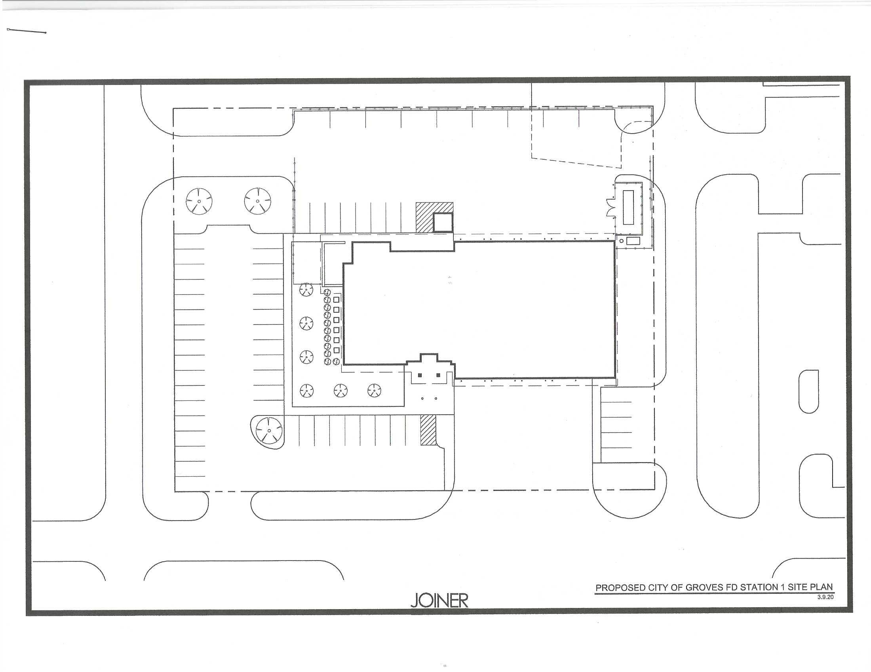

Slide 12
